Slide 1
Conversion of an image into json file using aws textract
Instructor : Dr. Kevin (Qixiang) Pang
Team members
Poojitha Manchi – 700758246
Sai Vikas Peddina – 700761953
Pavankalyan Nagelli – 700751765
Sannith Kumar Katla – 700757213

Slide 2
CONTENTS
Introduction
Architecture Overview
AWS services used
AWS Textract
S3 bucket
AWS Lambda
AWS CloudWatch
Conclusion

Slide 3
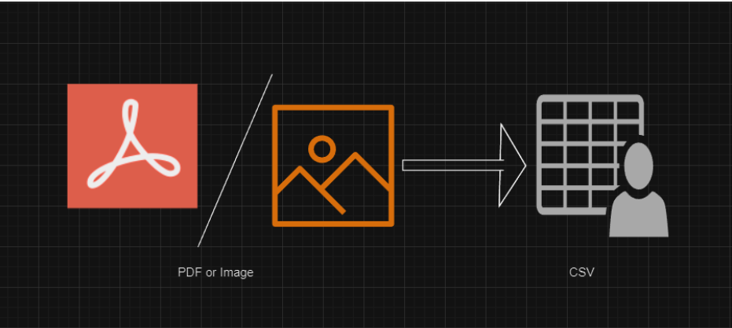
1. INTRODUCTION
Our goal is to create a system that converts an image file (such as JPG, PNG and JPEG) into structured data format that is JSON, using Amazon Web Services (AWS) Textract service. By utilizing Textract's advanced Optical Character Recognition (OCR) capabilities, the system will extract text and data from these documents. This will facilitate seamless integration into various applications and workflows. The focus will be on achieving accurate and efficient conversion while ensuring the system remains flexible and scalable.
image
JSON

Slide 4





Architecture overview
Upload image
Trigger
Lambda
User
S3 bucket
Calls Textract
output

Slide 5
2. AWS services used
Simple Storage Service(S3)
AWS Lambda
Textract
CloudWatch

Slide 6
S3 bucket
Overview
S3 (Simple Storage Service): Scalable, high-durability object storage service by AWS.
Key Features
Scalability: Automatically scales to handle large data volumes.
Durability: 99.999999999% durability with data replication across multiple facilities.
Availability : High availability for data access anytime.
Basic Components
Buckets: Containers for storing objects. Unique names globally.
Objects: Data files stored in buckets, each with a unique key.
Regions: Buckets are created in specific AWS regions for optimal latency and compliance.
Usage Examples
Backup and Restore: Secure, durable storage for backups.
Data Archiving: Cost-effective long-term storage.
Content Distribution: Hosting static websites and distributing media content.

Slide 7
AWS LAMBDA
Overview
Lambda : Serverless compute service that runs code in response to events and automatically manages the underlying compute resources.
Key Features
Event-Driven: Executes code in response to triggers such as changes in data, system state, or user actions.
No Server Management : Automatically handles infrastructure, so you only need to focus on your code.
Scalability : Automatically scales from a few requests per day to thousands per second.
Basic Components
Functions : The code you run on AWS Lambda. Each function has its own configuration and environment.
Triggers : Events that cause a Lambda function to execute, such as HTTP requests, changes in an S3 bucket, or updates to a DynamoDB table.
Execution Environment : The runtime environment in which your Lambda function executes, which includes the programming language runtime and other system libraries.
Usage Examples
Data Processing : Real-time file processing, data transformation.
Web Backends : Serve HTTP requests, APIs, and web applications.
Automation : Automate operational tasks, such as scheduled jobs, backups, and system monitoring.

Slide 8
Aws textract
In simple terms, the main purpose of AWS Textract is to help computers understand and extract text and data from scanned documents or images. It uses advanced technology to recognize the words and numbers in these documents, making it easier for computers to analyze and work with the information. Essentially, Textract helps turn pictures of text into usable digital data that computers can understand and process.

Slide 9
Use cases of textract
Faster Document Handling: Quickly organize and manage digital documents like invoices or receipts by extracting important details such as dates, amounts, and names.
Easier Financial Analysis: Analyze transaction records from bank statements to understand spending patterns or detect unusual activity.
Improved Customer Service: Retrieve relevant customer information from documents during calls to provide quicker and more personalized assistance.
Efficient Healthcare Management: Populate electronic health records with patient information extracted from medical forms for better patient care.

Slide 10
Use cases of textract
Streamlined Legal Processes: Analyze contracts to identify key terms or extract information for legal research or compliance purposes.
Better Retail Operations: Update inventory databases or analyze sales trends by extracting product information from catalogs or receipts.
Automated Grading: Grade exams more quickly by extracting scores from answer sheets and entering them into grading systems.
Simplified Research: Extract data from research papers or surveys for analysis and visualization in various research projects.

Slide 11
EVENT JSON FOR AWS LAMBDA
Overview
AWS Lambda functions receive event data in JSON format.
The structure and content depend on the event source (e.g., S3, DynamoDB, API Gateway).
Common Fields
Records : Array of event records, common in S3, DynamoDB and Kinesis events.
eventSource : Source of the event (e.g., `aws:s3`).
eventName : Type of event (e.g., `ObjectCreated:Put`).
Example Sources
1. S3 Event
Triggered by changes in an S3 bucket.
Includes details about the bucket and object (e.g., name, key, size).
2. API Gateway Event
Triggered by HTTP requests to API Gateway.
Includes HTTP method, headers, query parameters, and body.
Key Points
Event Source : Determines the structure and content of the event JSON.
S3 Events : Contain bucket and object details.
API Gateway Events : Contain HTTP request details.

Slide 12
AWS CLOUDWATCH
Overview
Monitoring and management service for AWS resources and applications.
Key Features
Metrics: Collects and tracks performance data.
Logs: Aggregates and monitors log files.
Alarms: Sends notifications or triggers actions
based on metrics.
Dashboards: Customizable visualizations of
metrics and logs.
Usage Examples
Performance Monitoring: Track EC2 instance performance.
Resource Optimization: Identify and optimize underutilized resources.
Troubleshooting : Gain insights from application logs.
Automated Responses : Trigger actions like scaling based on alarms.

Slide 13
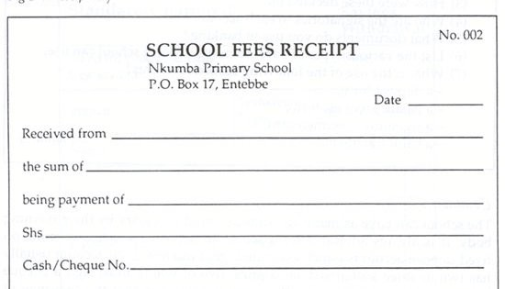
INPUT IMAGE

Slide 14
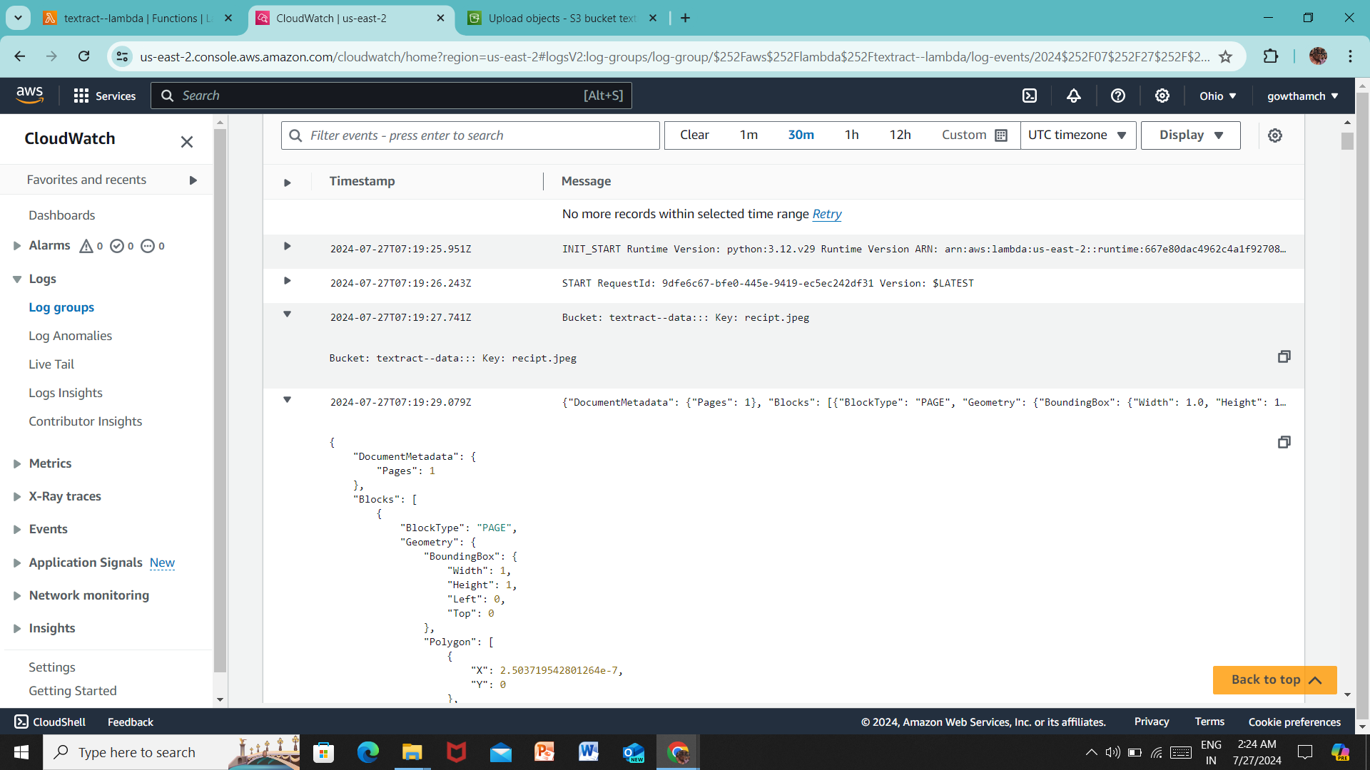
OUTPUT LOGS(json)

Slide 15
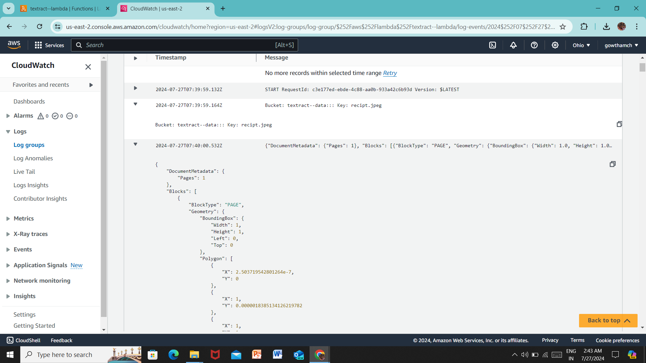
OUTPUT LOGS(json)

Slide 16
CONCLUSION
In conclusion, our project focused on developing an image conversion solution using AWS Textract, offering a promising opportunity to streamline document processing workflows and unlock the value of unstructured data. By leveraging cloud-native services and serverless computing, we've crafted a scalable, efficient, and cost-effective solution to tackle the challenges inherent in manual data extraction from images. With our solution, organizations can efficiently process documents, extract valuable insights, and expedite decision-making processes.

Slide 17
Any Queries ?

Slide 18
THANK YOU

